Slide 1
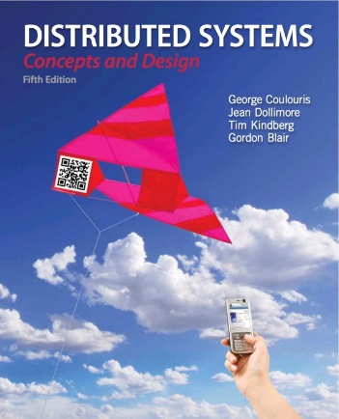
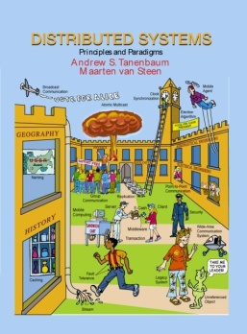
Distributed System Models
Presented by Dr. Anas Youssef
Lectures made by Dr. Rajkumar Buyya
Cloud Computing and Distributed Systems (CLOUDS) Laboratory
Department of Computing and Information Systems
The University of Melbourne, Australia
http://www.cloudbus.org/652
Most concepts are
drawn from Chapter 2
© Pearson Education
Some ideas from Chapter 1
© Pearson Education

Slide 2
Presentation Outline
Introduction
Architectural Models
  Software Layers
  System Architectures
    Client-Server
      Clients and a Single Sever, Multiple Servers, Proxy Servers with Caches, Peer Model
    Alternative Client-Sever models driven by:
      Mobile code, mobile agents, network computers, thin clients, mobile devices and spontaneous networking
    Design Challenges/Requirements
Fundamental Models – formal description
  Interaction, Failure, and Security models.
Summary

Slide 3
Outline
Architectural Models
  Introduction
  Architectural elements
  Architectural Patterns
    Layering
    Layering in distributed systems (platform, middleware)
    Middleware types
    Tiered architectures (two tier, three tier)
      Example: Tiered architectures for web-based systems
    J2EE tiered architectures

Slide 4
Outline
Architectural Models
  Introduction
  Architectural elements
  Architectural Patterns
    Layering
    Layering in distributed systems (platform, middleware)
    Middleware types
    Tiered architectures (two tier, three tier)
      Example: Tiered architectures for web-based systems
    J2EE tiered architectures

Slide 5
Architectural Models – Intro
The architecture of a system is its structure in terms of separately specified components.
  Its goal is to meet present and likely future demands.
  Major concerns are making the system reliable, manageable, adaptable, and cost-effective.
Architectural Model:
  Simplifies and abstracts the functions of individual components
  The placement of the components across a network of computers – define patterns for the distribution of data and workloads
  The interrelationship between the components – i.e., the components function roles and the patterns of communication between them.
Notes:
Goal: Forward looking. Design choices need to be made considering future demand. What might suit 10 users is terrible for 10,000 users. RELATE TO ASSIGNMENT/Dictionary design!!! Reliability/maintainability is crucial (e.g. need to add feature)
Using a well defined and well chosen architectural model can help in this respect!!
By abstracting and componentizing our model, we can enable it to be distributed and “scaled-out” based on changing needs

Slide 6
Architectural Models
The architecture of a system is its structure in terms of separately specified elements
and their interrelationships.
Hence, we will explain:
  Architectural elements
  Architectural patterns
  Existing middleware platforms that support the above architectural elements and architectural patterns

Slide 7
Outline
Architectural Models
  Introduction
  Architectural elements
  Architectural Patterns
    Layering
    Layering in distributed systems (platform, middleware)
    Middleware types
    Tiered architectures (two tier, three tier)
      Example: Tiered architectures for web-based systems
    J2EE tiered architectures

Slide 8
Architectural Models – Architectural Elements
What are the entities that are communicating in the distributed system?
  Objects:
    Objects have been introduced to enable and encourage the use of object-oriented approaches in distributed systems
    Objects are accessed via interfaces, with an associated interface definition language (or IDL) providing a specification of the methods defined on an object.
    Example?
Notes:
Example? Remote Method Invocation

Slide 9
Architectural Models – Architectural Elements
What are the entities that are communicating in the distributed system?
  Components
    Problem-oriented abstractions for building distributed systems and are also accessed through interfaces
    Assumptions?
    Example?
  Webservices
    Web services represent an important paradigm for the development of distributed systems
    Integrated into the world wide web
Notes:
Components resemble objects in that they offer problem-oriented abstractions for building distributed systems and are also accessed through interfaces
Assumptions? The key difference is that components specify not only
their (provided) interfaces but also the assumptions they make in terms of other
components/interfaces that must be present for a component to fulfil its function – in
other words, making all dependencies explicit and providing a more complete
contract for system construction.
Example? CORBA

Slide 10
Architectural Models – Architectural Elements
How do those entities communicate in a distributed system?
  Inter process communication refers to the relatively low-level support for communication between processes in distributed systems, including message-passing primitives, direct access to the API offered by Internet protocols (Example ?)
  Remote invocation covers a range of techniques based on a two-way exchange between communicating entities in a distributed system and resulting in the calling of a remote operation, procedure or method (Example ?)
Notes:
Example 1: Socket programming
Example 2: RPC, RMI

Slide 11
Architectural Models – Architectural Elements
How do those entities communicate in a distributed system?
  Indirect communication
    Group communication: Group communication is concerned with the delivery of messages to a set of recipients and hence is a multiparty communication paradigm supporting one-to-many communication.
    Publish-subscribe systems
    Message queues
Notes:
Publish-subscribe systems: Many systems, such as the financial trading example in
Chapter 1, can be classified as information-dissemination systems wherein a large
number of producers (or publishers) distribute information items of interest (events)
to a similarly large number of consumers (or subscribers)
Message queues: Whereas publish-subscribe systems offer a one-to-many style of
communication, message queues offer a point-to-point service whereby producer
processes can send messages to a specified queue and consumer processes can
receive messages from the queue or be notified of the arrival of new messages in the
queue. Queues therefore offer an indirection between the producer and consumer
processes.

Slide 12
Outline
Architectural Models
  Introduction
  Architectural elements
  Architectural Patterns
    Layering
    Layering in distributed systems (platform, middleware)
    Middleware types
    Tiered architectures (two tier, three tier)
      Example: Tiered architectures for web-based systems
    J2EE tiered architectures

Slide 13


Architectural Models – Architectural Patterns
One classification for architectural patterns stems from the role on processes within those patterns.
An initial simplification is achieved by classifying processes as:
    Server processes
    Client processes
    Peer processes
      Cooperate and communicate in a symmetric manner to perform a task.
client
server
Dictionary server example.
Client-server or peer-to-peer?
peer
peer
Notes:
At a high level we can look at the application and user requirements, and classify the individual processes and logic as Server, Client or Peer processes.
Take the Dictionary server as an example. We could have had one monolithic application, with all words and interface available locally.
However, a client-server approach may be more efficient. Previous queries could be cached locally. Word additions, removes and modifications can be done centrally. C/S is valid approach!
Could use a peer model where each peer has a segment of Dictionary

Slide 14
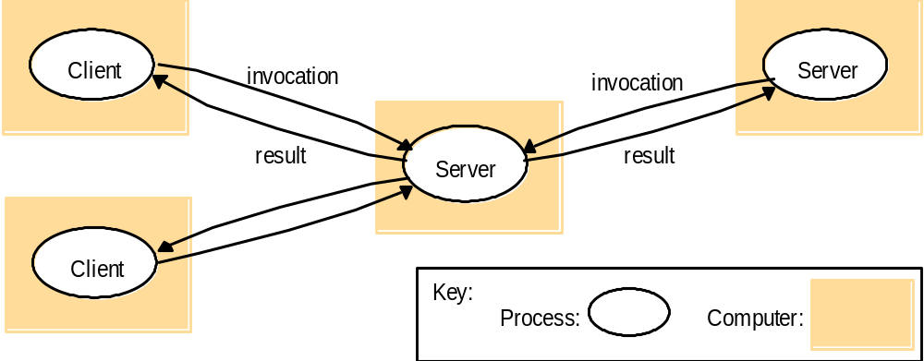
Client-Server Basic Model:
Clients invoke individual servers
Client processes interact with individual server processes in a separate computer in order to access data or resource. The server in turn may use services of other servers.
Example?
Notes:
Querying a web server (server 1), which could then query a mysql or oracle database (server 2) before returning the content of a page
Examples:
1. Web server is a client of the database server
2. A search engine, as well as serving search requests from clients, crawls other websites to keep its information current.
Search engine is both a server and a client for other web servers.

Slide 15
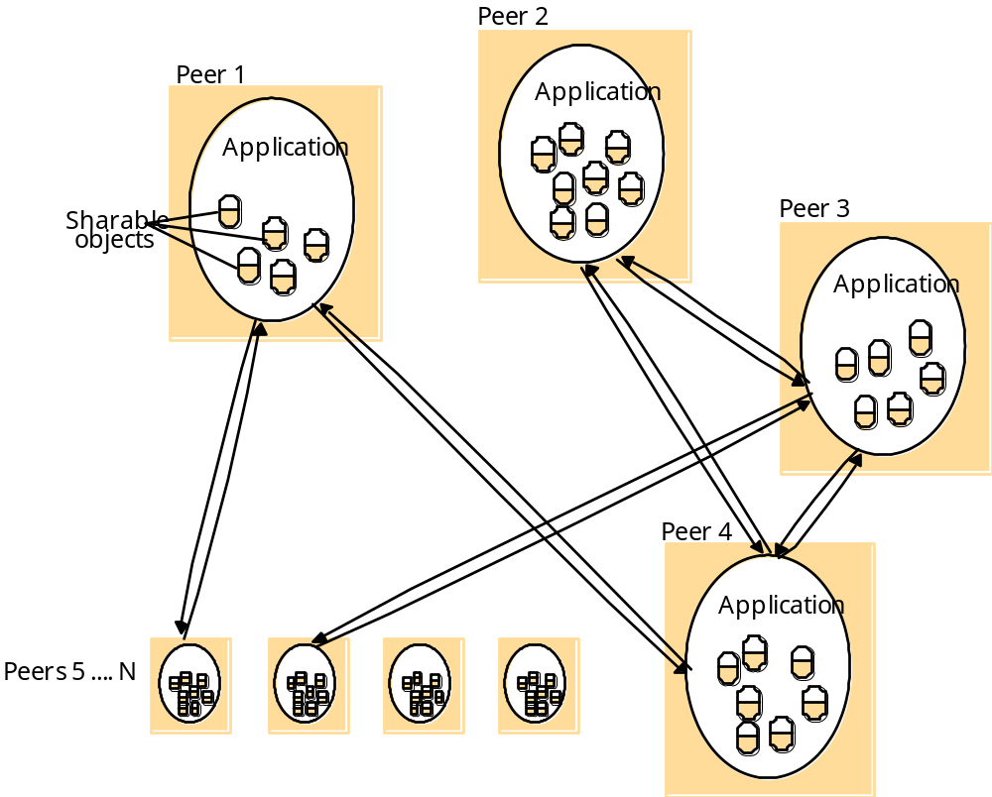
Peer Processes: A distributed application based on peer processes
All of the processes play similar roles, interacting cooperatively as peers to perform distributed activities or computations without distinction between clients and servers. (Examples?)
Pros/Cons?
Notes:
Peer to peer: E.g., music sharing systems Napster, Gnutella, Kaza, BitTorrent.
Distributed “white board” – users on several computers to view and interactively modify a picture between them.
Pros/Cons
-No central point of failure (reliable)
-No central point of control (difficult to deny service for adversaries)
-Some peers will typically contribute more than others (I.e. seed or super-peer) → The node that has the new movie of Ahmed Helmy!

Slide 16



P2P with a Centralized Index Server
(e.g. Napster Architecture)
peer
peer
peer
peer
peer
peer
peer

Slide 17
Outline
Architectural Models
  Introduction
  Architectural elements
  Architectural Patterns
    Layering
    Layering in distributed systems (platform, middleware)
    Middleware types
    Tiered architectures (two tier, three tier)
      Example: Tiered architectures for web-based systems
    J2EE tiered architectures

Slide 18
Architectural Patterns - Layering
Breaking up the complexity of systems by designing them through layers and services
  Layer: a group of related functional components
  Service: functionality provided to the next layer.
Lower level
details
awareness?
Layer N
…
Layer 2
(services offered to above layer)
Layer 1
Notes:
Layers exist in the “stack” at both a single machine and between multiple machines
Operating systems typically split functionality into layers, and hide the complexity of many common operations from users and programmers.
Layers access levels above and below them as “services”
A distributed service can be provided by one or more server
processes, interacting with each other and with client processes in order to maintain a consistent system-wide view of the service’s resources.
Lower level details awareness?
A given layer therefore offers a software abstraction, with higher layers being unaware of implementation details, or indeed of any other layers beneath them.

Slide 19
Outline
Architectural Models
  Introduction
  Architectural elements
  Architectural Patterns
    Layering
    Layering in distributed systems (platform, middleware)
    Middleware types
    Tiered architectures (two tier, three tier)
      Example: Tiered architectures for web-based systems
    J2EE tiered architectures

Slide 20
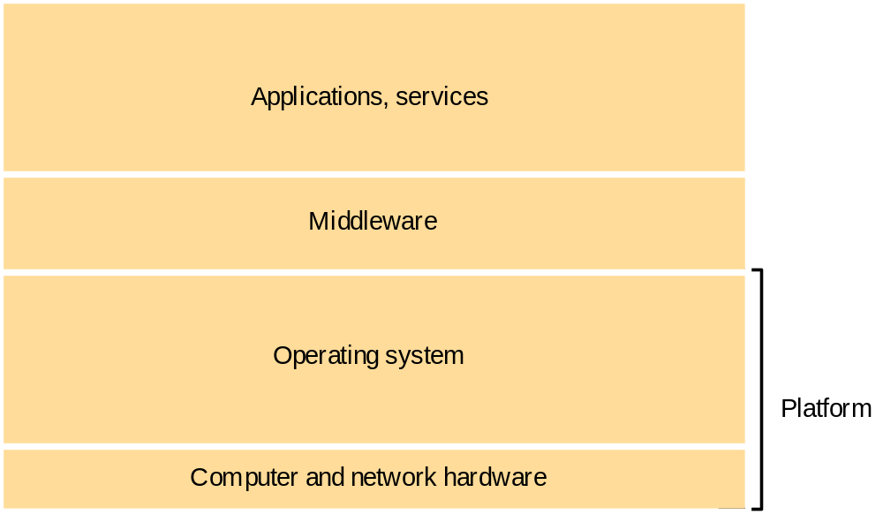
Software and hardware service layers in distributed systems
Notes:
A networked computer operating system is a perfect example of this layering
Users interact with applications and services using the GUI or CLI
Applications and services depend on middleware and OS functions to do anything useful (RPC/RMI/TCP+IP)
Middleware/OS access the hardware and network links directly to send and receive information

Slide 21
Software and hardware service layers in distributed systems
Recall the distributed
system’s definition?
Notes:
A distributed system consists of a set of independent computers connected through some network
Green rectangle→ Each independent computer has different computer hardware and network hardware and different operating system. Those items are collectively referred to as a platform

Slide 22
Platform
The lowest hardware and software layers are often referred to as a platform for distributed systems and applications.
These low-level layers provide services to the layers above them, which are implemented independently in each computer.
Major Examples
    Intel x86/Windows
    Intel x86/Linux
    Intel x86/Solaris
    PowerPC/MacOS
    iPhone/iOS
    Samsung Galaxy/Android
Notes:
Even thought these platforms are reasonably disparate (Unix, Windows) & (x86, PPC, SPARC) they still have a core set of services and middleware in common. This is essential to enable these platforms to communicate, interoperate and collaborate together with minimal effort.
We don’t want to be converting between little endian/big endian or have to care about the specifics of each platform at the higher level

Slide 23
Software and hardware service layers in distributed systems
A layer of software whose purpose is to mask heterogeneity and to
provide a convenient programming model to application programmers
Notes:
Middleware is a type of architecture used to facilitate communications of
services available and requests for these services between two applications
that are operating on environmentally different systems.
E,g, the JVM is a middleware that enables your chatting client on windows machine talk to another client on a linux machine
A networked computer operating system is a perfect example of this layering
User’s interact with applications and services using the GUI or CLI
Applications and services depend on middleware and OS functions to do anything useful (RPC/RMI/TCP+IP)
Middleware/OS access the hardware and network links directly to send and receive information

Slide 24
Middleware Prior Options
What were the prior middleware options to get heterogenous machines to communicate?
  E.g., a Windows machine and a Linux machine
  What happen if we add a Solaris machine?

Slide 25
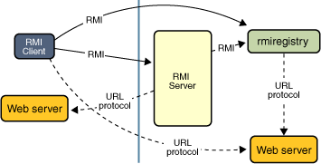
Middleware
A layer of software whose purpose is to mask heterogeneity present in distributed systems and to provide a convenient programming model to application developers.
Major Examples:
    Sun RPC (Remote Procedure Call)
    OMG CORBA (Common Object Request Broker Architecture)
    Microsoft D-COM (Distributed Components Object Model)
    Sun Java RMI (Remote Method Invocation)
    Modern Middleware Examples:
      Manjrasoft Aneka– for Cloud computing
      IBM WebSphere
      Microsoft .NET
      Sun J2EE
      Google AppEngine
      Microsoft Azure
Notes:
To enable us to be truly platform agnostic, we need a core set of middleware and functions that we can use on all platforms
Sun RPC is available on most Unix platforms
CORBA is a distributed middleware that is available for all major platforms
Java RMI is available on any platform there is a compliant JVM install
.NET is becoming a standard, and is available for Windows/Linux/MacOS
Higher level middleware (Gridbus/Globus) can hide even more complexity

Slide 26
System Architecture
The most evident aspect of DS design is the division of responsibilities between system components (applications, servers, and other processes) and the placement of the components on computers in the network.
It has major implication for:
  Performance, reliability, and security of the resulting system.
Notes:
The decisions that you make as system designers is crucial [tradeoffs]
Moving some load to client (e.g. applet execution) can improve response and allow SOME disconn. access, but can be a security risk.
Moving complexity on server can reduce client requirements and lower the entry bar (e.g. server based CGI/PHP, client only needs browser)
TRADEOFFS!!!

Slide 27




Client-Server Architecture Types
(Tier arch compliments layer architecture)
    Two-tier model (classic)
    Three-tier (when the server, becomes a client)
    Multi-tier (cascade model)
client
server
client
Server/client
server
server
client
Server/client
Server/client
server

Slide 28
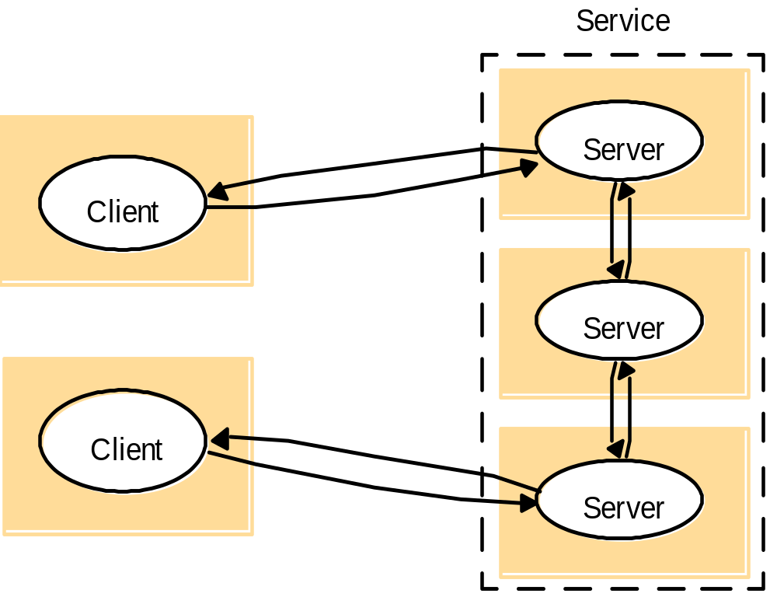
A service provided by multiple servers
Services may be implemented as several server processes in separate host computers.
Example: Cluster based Web servers and apps such as Google, parallel databases Oracle
Notes:
This topology is extremely common. A web site like google serves approximately 100M searches a day.
It is obviously simply not feasible to serve them from a single server.
Google uses clusters containing 10’s of thousands of machines offering equivalent services, and you are redirected (via DNS and other means) to one of them. Can also be redirected at protocol or application level.
Similar techniques can be used for Oracle databases, that are replicated over many servers to offer redundancy and performance

Slide 29
Outline
Architectural Models
  Introduction
  Architectural elements
  Architectural Patterns
    Layering
    Layering in distributed systems (platform, middleware)
    Middleware types
    Tiered architectures (two tier, three tier)
      Example: Tiered architectures for web-based systems
    J2EE tiered architectures

Slide 30
Architectural Patterns – Tiered Architecture
Tiered architectures are complementary to layering (how?)
Mostly associated with the organization of applications and services within the prior Layering figure
Applies to all layers of a distributed system’s architecture.
Notes:
How?
Tiering is a technique to organize functionality of a given layer and place this functionality into appropriate servers and, as a secondary consideration, on to physical nodes.
Let us see where does the middleware concept fit in here? (between each tier and the following one, they communicate through middleware, because each tier is, actually, a different machine. For example, in the three-tier architecture, the client is one machine, and communicates with the webserver through the RMI middleware architecture)

Slide 31
Architectural Patterns – Tiered Architecture
Consider the functional decomposition of a given application, as follows:
  the presentation logic
  the application logic
  the data logic
Notes:
the presentation logic, which is concerned with handling user interaction and
updating the view of the application as presented to the user;
the application logic, which is concerned with the detailed application-specific
processing associated with the application (also referred to as the business logic,
although the concept is not limited only to business applications);
the data logic, which is concerned with the persistent storage of the application,
typically in a database management system.

Slide 32
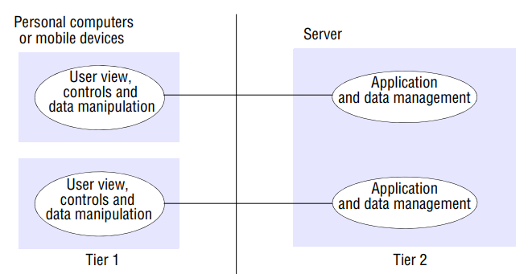

Architectural Patterns – Two Tiered Architecture
Pros/Cons
Where would the middleware fit here (e.g., RMI)?
Notes:
In the two-tier solution, the three aspects mentioned above must be partitioned
into two processes, the client and the server. This is most commonly done by splitting the application logic, with some residing in the client and the remainder in the server
Pros. The advantage of this scheme is low latency
in terms of interaction, with only one exchange of messages to invoke an operation
Cons.
Where would the middleware fit here (e.g., RMI)?
IT is the thin horizontal line tying tier 1 and tier 2

Slide 33
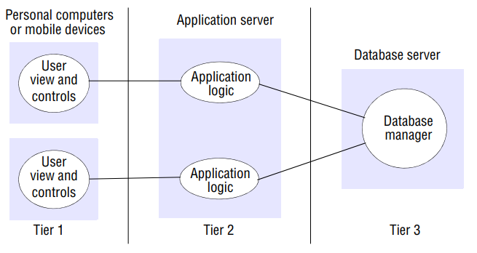
Architectural Patterns – Three Tiered Architecture
Pros/Cons
Where would the middleware fit here (e.g., RMI)?
Notes:
In the three-tier solution, there is a one-to-one mapping from logical elements to
physical servers and hence, for example, the application logic is held in one place, which in turn can enhance maintainability of the software.
Each tier also has a well-defined role; for example, the third tier is simply a database offering a (potentially standardized)
relational service interface. The first tier can also be a simple user interface allowing
intrinsic support for thin clients (as discussed below). The drawbacks are the added
complexity of managing three servers and also the added network traffic and latency
associated with each operation.
Pros. Maintainability, Scalability (How)
Cons. latency

Slide 34
Required Readings
Chapter 2 from the text book: Coulouris, George F., Jean Dollimore, and Tim Kindberg. Distributed systems: concepts and design. Fifth Edition.

